Slide 1
Improving Preparedness of Communities for Evacuations using ZEVs
Planning Infrastructure Investments
Saeed Aliamooei Lakeh (UC Santa Cruz)
December 05, 2024

Slide 2

Introduction
Saeed Aliamooei Lakeh
PhD Student,
Electrical and Computer Engineering Department,
University of California, Santa Cruz.
Smart Power Lab
Advisors:
Dr. Keith Corzine
Dr. Leila Parsa
Field of Research:
Power Systems Planning, Operation, and Control
Power Electronics Converters
Microgrids Control and Stability
Renewable Energy Sources and Electric Vehicles
saliamoo@ucsc.edu

Slide 3
Outline
Overview of the Project Procedure
Operation and Resilience
Infrastructure Investment
Evacuation Scenario
Results and Discussion
Fact Sheet

Slide 4
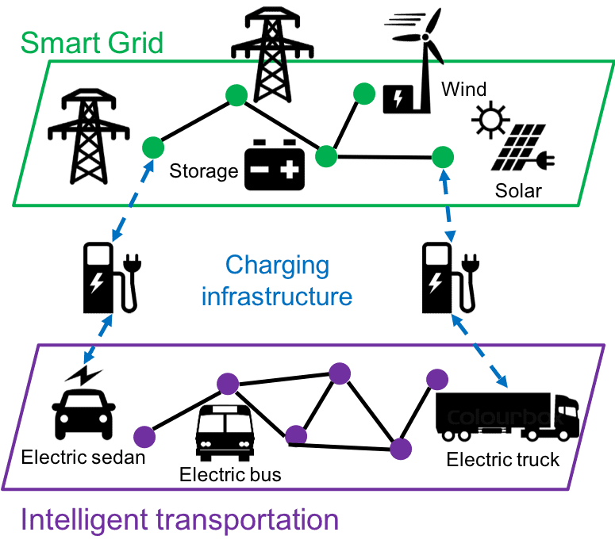
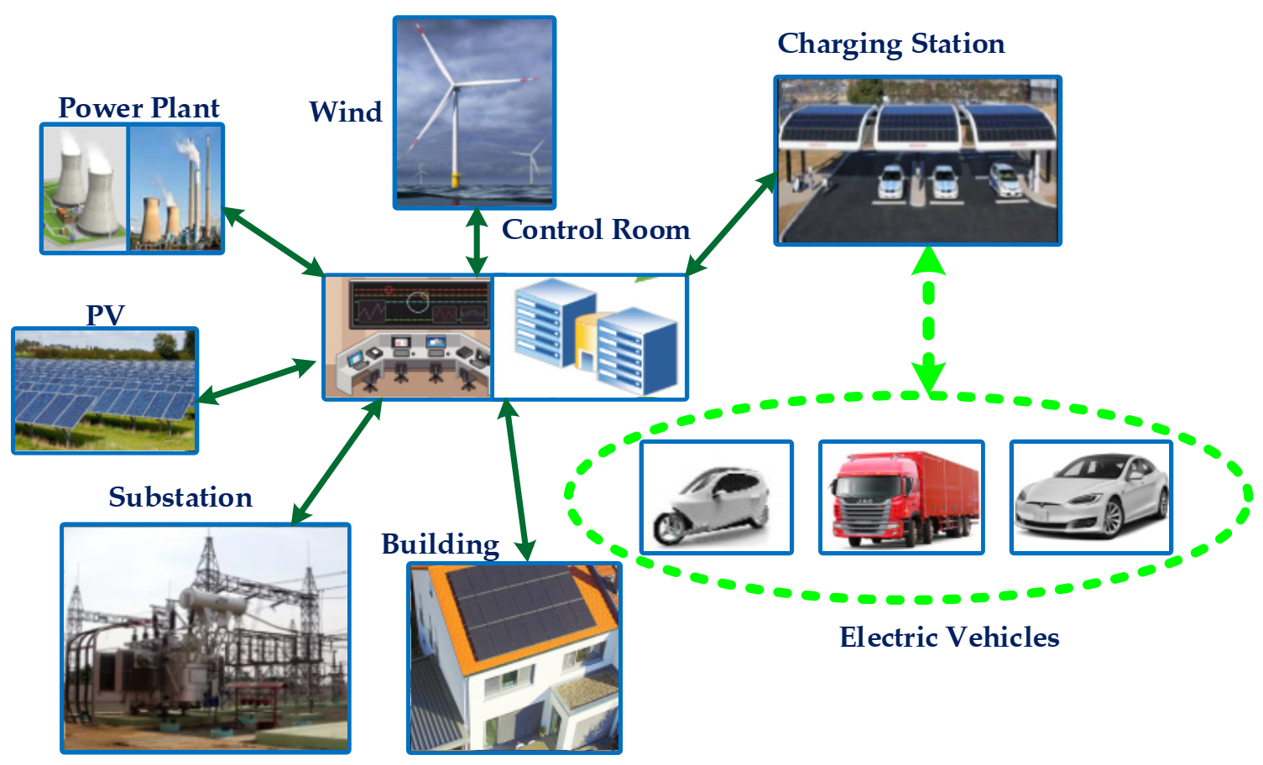
Structure of the Systems: Power and Transportation

Slide 5

Overview of Task #2
Specifications of Systems
Vulnerability Analysis
and Power System Operation
Cost-benefit Infrastructures
Electrical Factors
Optimization Problem
Power Systems
Failure Rate
Operation and Planning
Microgrids
Uncertainties
Decision-aid Tools
Renewable Energy Sources
Infrastructure Vulnerability Analysis
Best action
in evacuations
Electrical Vehicles
Suitable Method
Prediction and forecasting
Energy Storage Systems
Transportation Networks
Charging Stations
Traffic and Road Expansion
Weights from experts
Existing Roads
Fastest Path

Slide 6
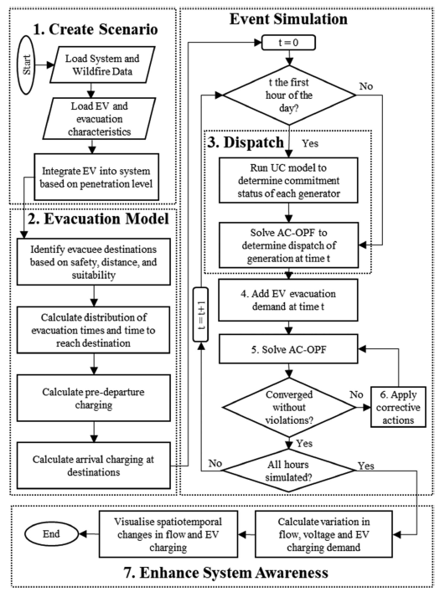
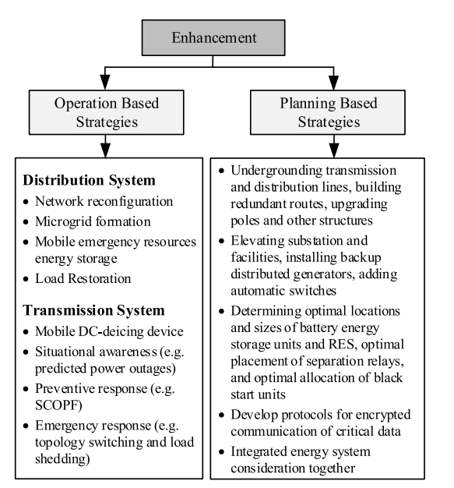
Power Systems Studies

Slide 7
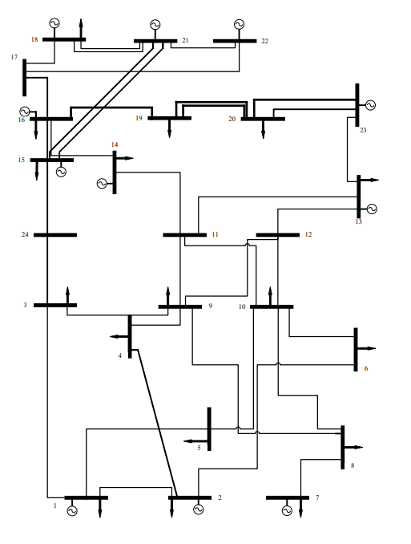
Case Study
Use cases: 7-bus, 24-bus, and 37-bus power system
Buses:
Number of Buses: 24
Bus Types: Includes slack (reference), generator, and load buses
Voltage Levels:
Multiple voltage levels: Common ones might be 138 kV and 230 kV
Generators:
Locations: Specified at certain buses (not all buses have generators)

Slide 8
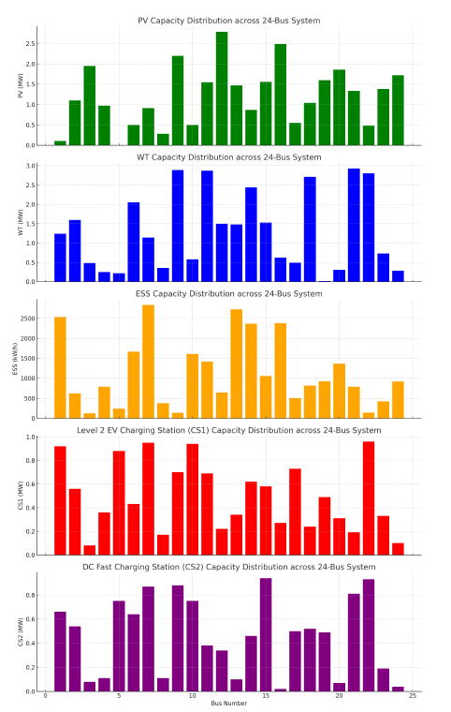
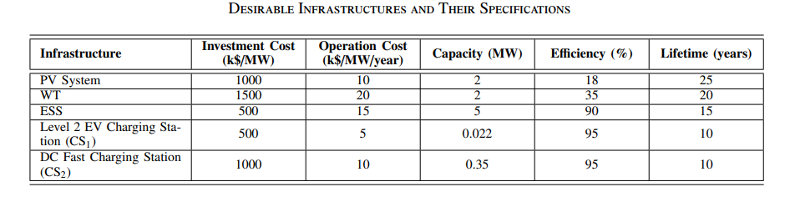
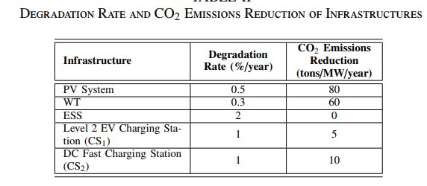
Infrastructure Investment

Slide 9
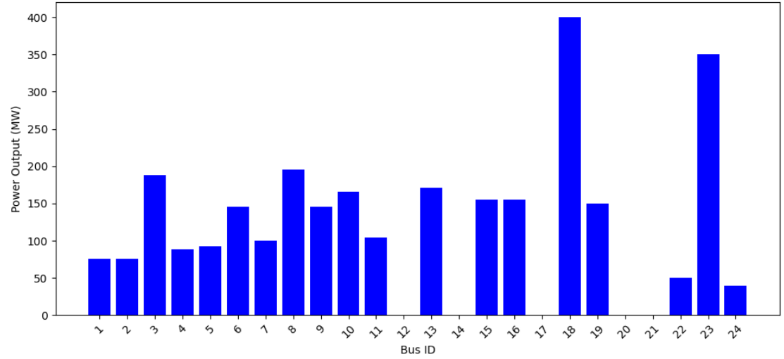
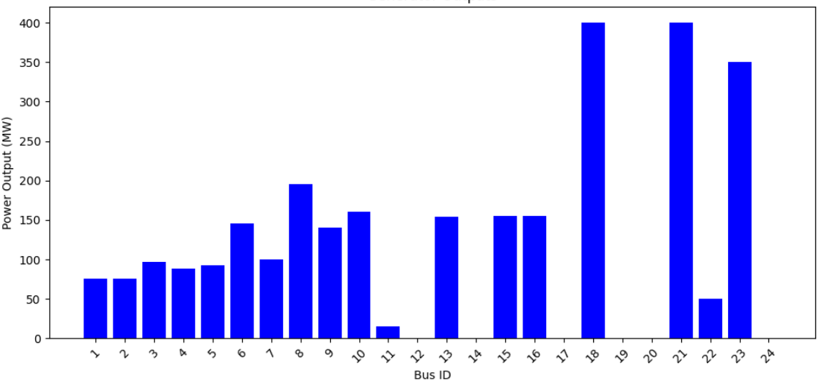
Results and Discussion (Optimal Power Flow)
N-1: Generator #21 Fails

Slide 10
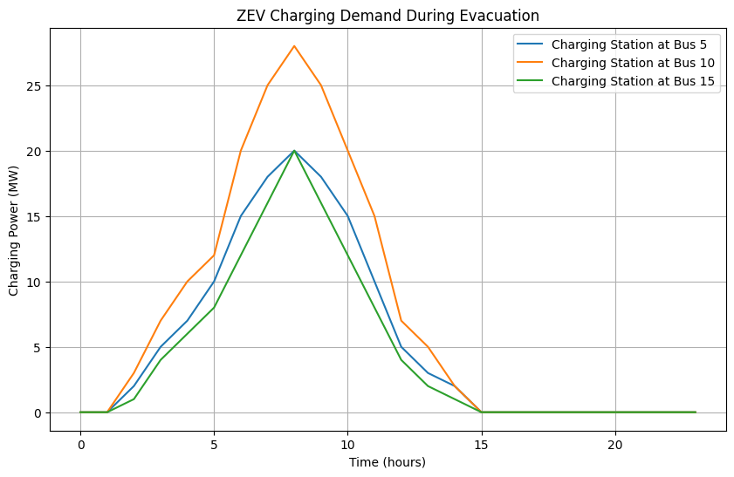
Evacuation Scenario - 1
Scenario 1: Minimal ZEV Adoption Limited grid stress, underutilized infrastructure. Highlighted need for adaptive load management.
Scenario 2: Moderate ZEV Penetration Increased grid complexity and charging demand. Real-time OPF managed demand but revealed bottlenecks.
Scenario 3: High ZEV Adoption Significant grid challenges: voltage drops, power losses. Renewable integration and ESS improved resilience.

Slide 11
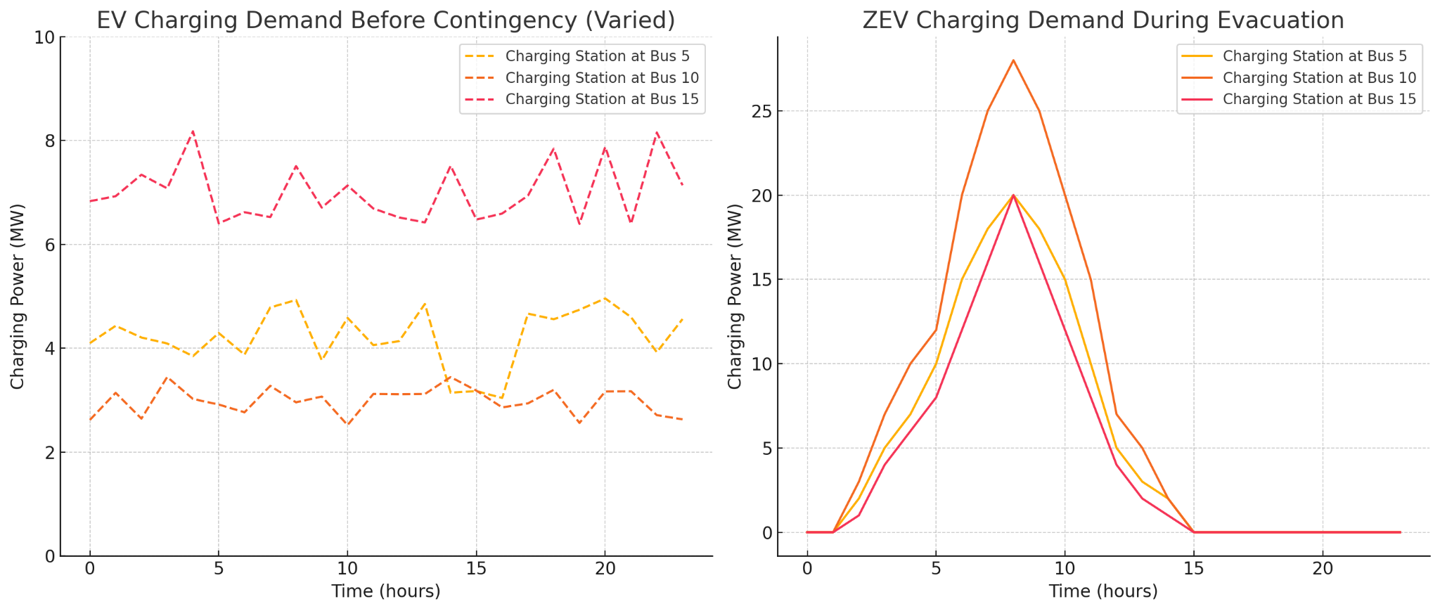
Evacuation Scenario - 2

Slide 12
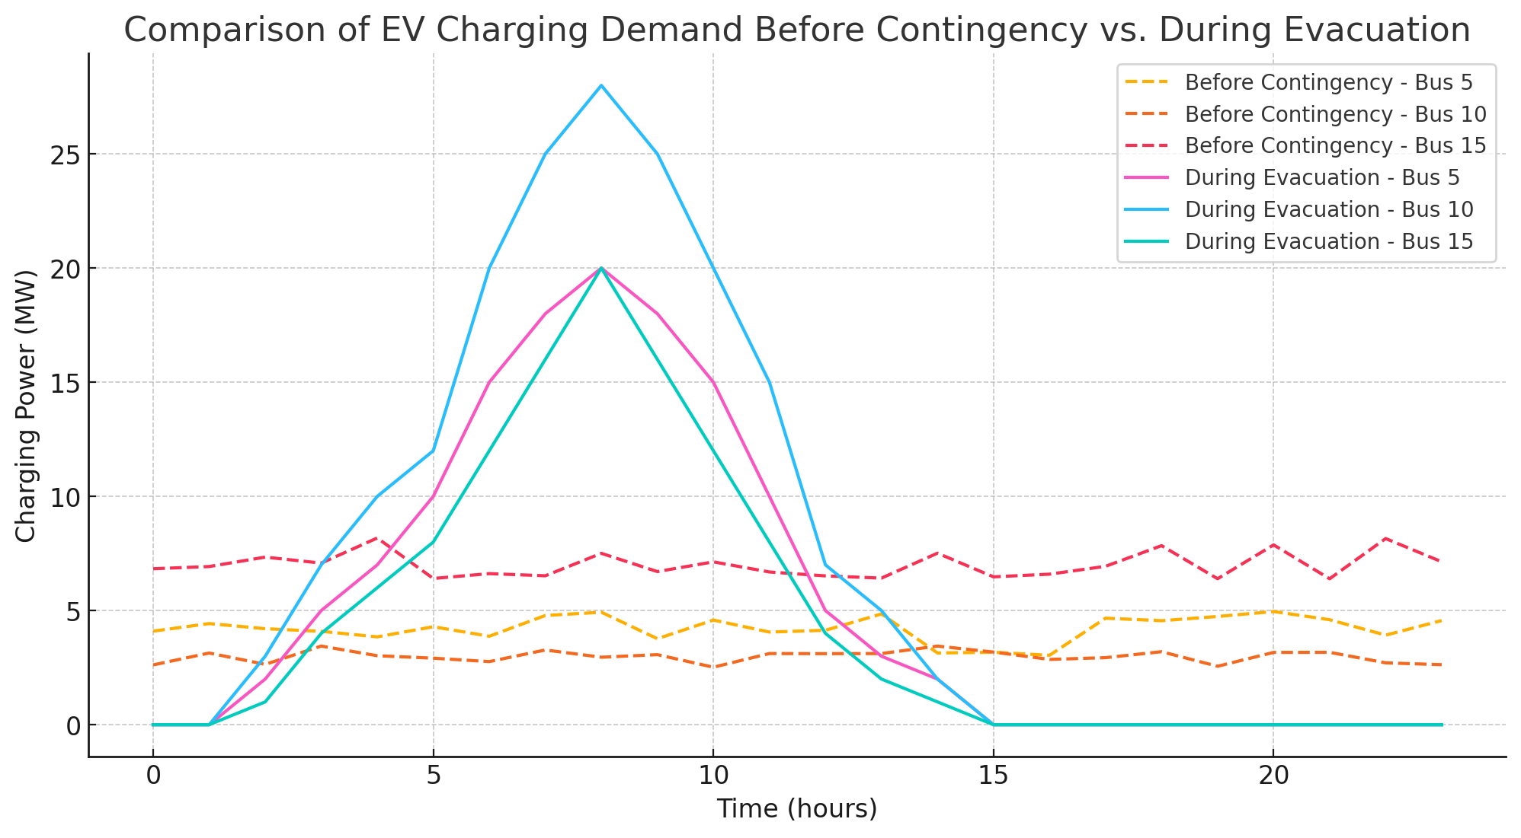
Evacuation Scenario - 3
Evacuation Impact: Sharp demand peaks highlight stress on the grid during evacuation. Concentrated charging period requires advanced load management.
Grid Challenges: High demand can lead to instability without proper management. Real-time OPF and demand response strategies are essential.
Recommendations:
Increase charging station capacity at high-demand buses (Infrastructure investment).
Deploy Energy Storage Systems (ESS) for peak demand buffering.
Use AI tools for demand forecasting and real-time adjustments.

Slide 13
Community Partners
Challenges in the Project:
1. Data Gaps:
Lack of detailed real-time ZEV charging demand and grid data.
Limited access to historical outage and emergency response records.
2. Uncertainty in Evacuation Scenarios:
Highly dynamic ZEV loads and unpredictable demand spikes.
Need for robust models to simulate real-world evacuation scenarios.
3. Integration Issues:
Balancing ZEV charging with grid stability and renewable integration.

Slide 14
Community Partners
Data Requests:
1. ZEV Charging Infrastructure and Energy Need:
Locations and capacities of existing charging stations.
Charging demand patterns during normal and emergency conditions.
2. Power System Resilience:
Historical data on power outages during emergencies.
Current capacities and response times of energy storage systems.
availability of renewable energy sources at different locations.
3. Evacuation Scenarios: Records of previous disaster and evacuation events involving ZEVs.
4. Emergency Management Criteria: Key factors for prioritizing infrastructure investments and constraints during evacuations.

Slide 15


Q&A?
Thanks for your attention!
My LinkedIn:
saliamoo@ucsc.edu

